Slide 1

শিক্ষা নিয়ে গড়বো দেশ তথ্য-প্রযুক্তির বাংলাদেশ
BANGABANDHU SHEIKH MUJIBUR RAHMAN DIGITAL UNIVERSITY, BANGLADESH
PRESENTATION
COURSE CODE-DS 107
COURSE TITLE-PROBABILITY AND STATISTICS
PRESENTATION TITLE-BAYES’ THEOREM
PREPARED BY:
MD. SHAHIDUL ISLAM (ID:2101012)
MEHRIN FARZANA (ID:2101013)
IFTY IMAM BIN RAZZAK (ID:2101014)
SRABONEE PAUL TULI (ID:2101015)
TANJIM INTISAR SIJAN (ID:2101016)
MD ZUNAID HOSSAIN (ID:2101017)
ARGHYA DAS (ID:2101018)
INSTRUCTED BY:
MOHAMMAD MEHEDI HASAN
LECTURER
DEPARTMENT OF IRE, BDU

Slide 2
DETERMINISTIC& STOCHASTIC OPTIMIZATION
Operations research has been particularly successful in two areas of decision analysis:
Deterministic optimization: Optimization of problems involving many variables when the outcome of the decisions can be predicted with certainty, and
Stochastic optimization: The analysis of situations involving a few variables when the outcome of the decisions cannot be predicted with certainty.
Real world problems almost invariably include some unknown and uncertain parameters.

Slide 3
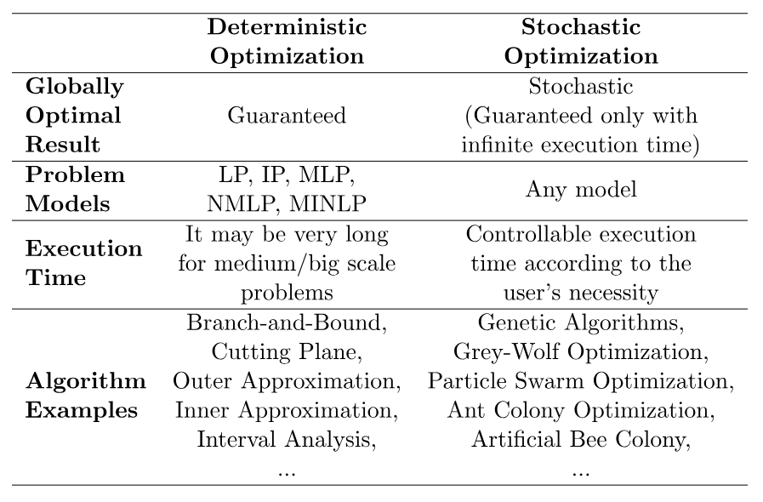

Slide 4
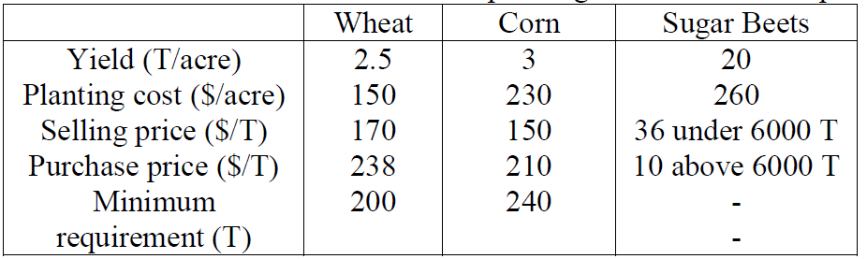
EXAMPLE
A farmer raises wheat, corn, and sugar beets on 500 acres of land. Before the planting season he wants to decide how much land to devote to each crop.
• At least 200 tons of wheat and 240 tons of corn are needed for cattle feed, which can be purchased from a wholesaler if not raised on the farm.
• Any grain in excess of the cattle feed requirement can be sold at $170 and $150 per ton of wheat and corn, respectively.
• The wholesaler sells the grain for 40% more (namely $238 and $210 per ton, respectively.)
• Up to 6000 tons of sugar beets can be sold for $36 per ton; any additional amounts can be sold for $10/ton.
• Based on past experience, the farmer knows that the mean yield on his land is roughly 2.5T,3T,and 20T per acre for wheat, corn, and sugar beets, respectively.
Summarizes These Data And The Planting Costs For These Crops

Slide 5
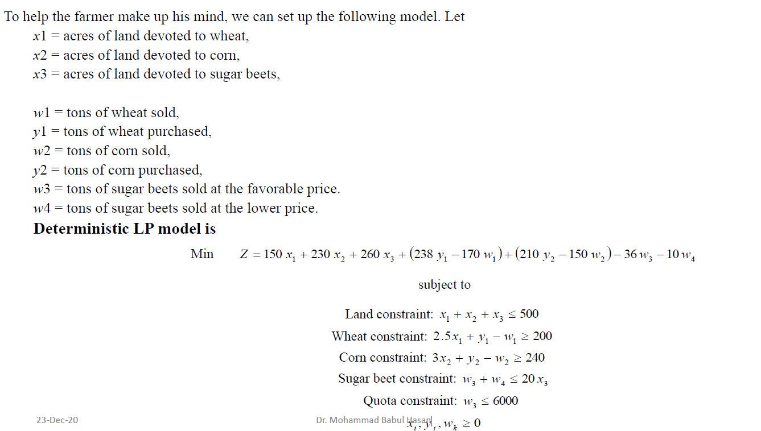

Slide 6
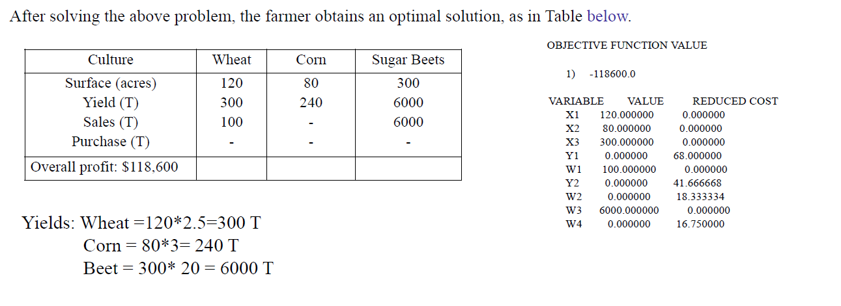
DETERMINISTIC SOLUTION
Table 2:Optimal solution based on average yields

Slide 7
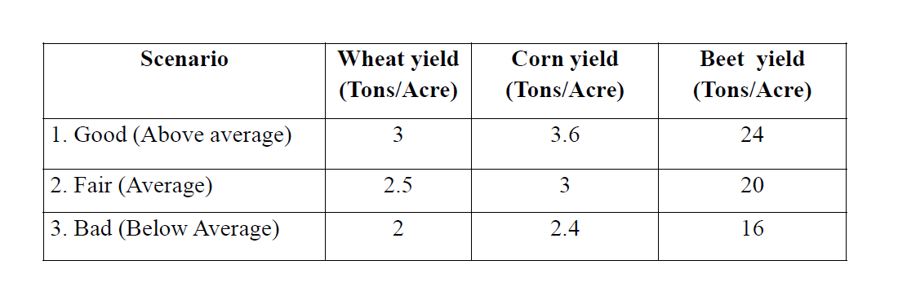
A SCENARIO REPRESENTATION (STOCHASTIC APPROACH WITH DISCRETE VARIABLES)

Slide 8
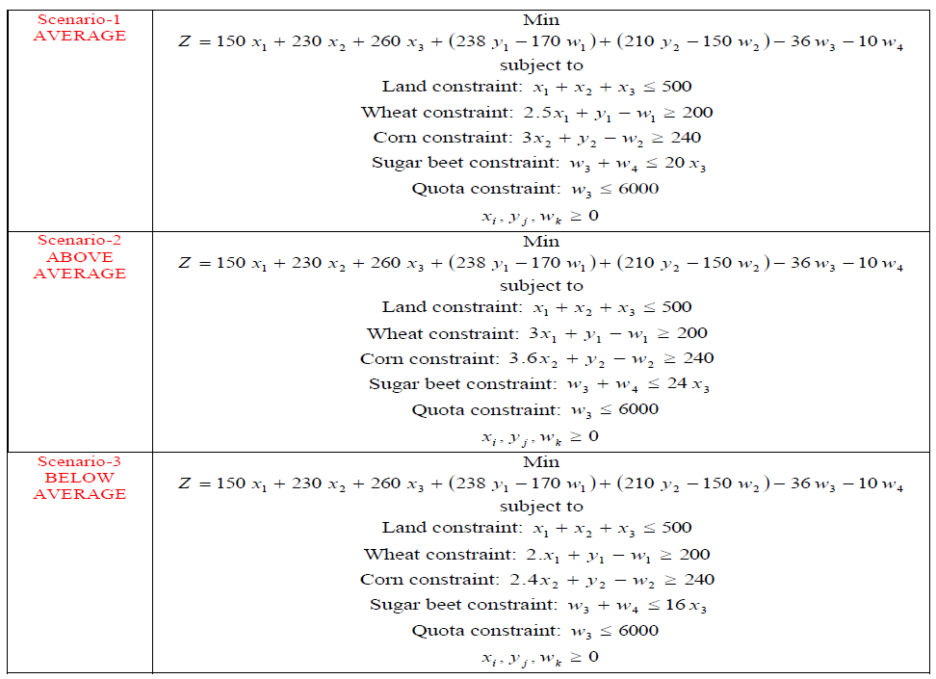
A SCENARIO REPRESENTATION (STOCHASTIC APPROACH WITH DISCRETE VARIABLES)

Slide 9
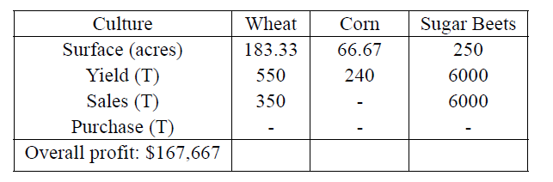
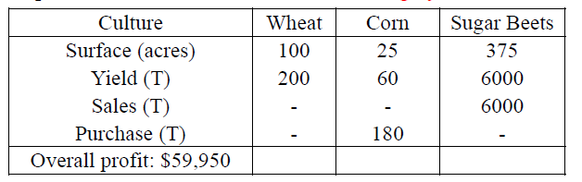
Table 1:Optimal solution based on above average yields(+ 20%).
Table 3:Optimal solution based on above average yields (-20%).

Slide 10
Thanks!

